Slide 1
Commercial in Confidence
COMPETITIVE ANALYSIS

Slide 2
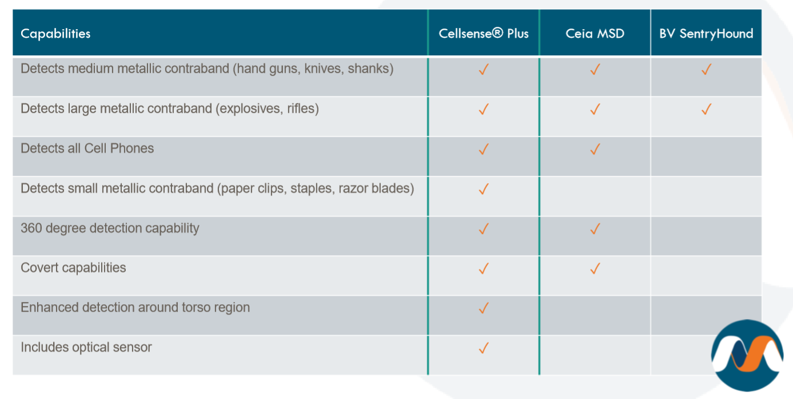
Commercial in Confidence
Notes:
金属 雷达 传感器

Slide 3
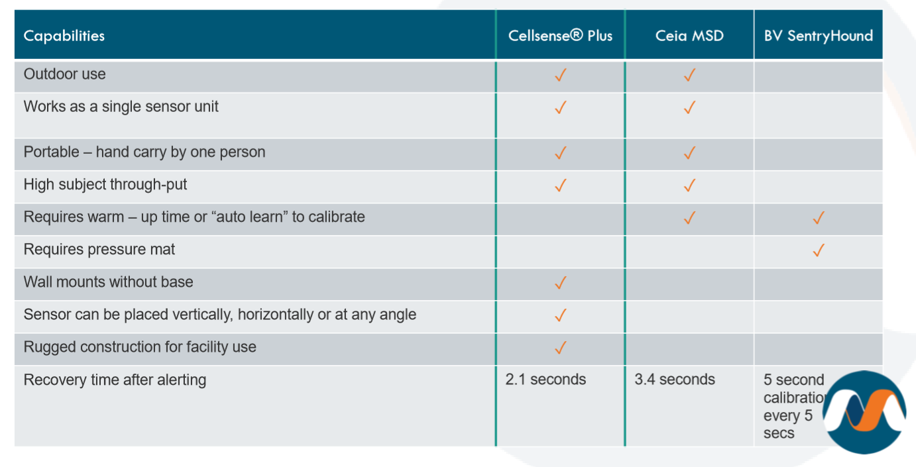
Commercial in Confidence
Notes:
金属 雷达 传感器

Slide 4
Commercial in Confidence
Notes:
金属 雷达 传感器

Slide 5
Commercial in Confidence
Intertek is a British multinational assurance, inspection, product testing and certification company headquartered in London, United Kingdom.
It is listed on the London Stock Exchange and is a constituent of the FTSE 100 Index.
It is 130 years in business, Intertek is an industry leader with more than 43,000 employees in 1,000 locations in over 100 countries.
Some of its clients include:
Kraft Foods
Carrefour
Petroleum Authority of Thailand (PTT Oil)
Unilever
Notes:
金属 雷达 传感器

Slide 6
Commercial in Confidence
Notes:
金属 雷达 传感器

Slide 7
Commercial in Confidence
Model Tested: The Cellsense Plus model was supplied for testing, but the results can be applied to Proscreen 500 as well.
Objective of Test: To find out the overall average detection rates for all 3 screening methods.
Walk By
360°
Full screening
In the follow threat categories,
All threat items
All threat items excluding cell phones

Slide 8
Commercial in Confidence
Screening Methods | Threat Items | *Locations On Body
Walk By: Between ~ 20cm to 81cm from centre of Pole |  | *Trouser pocket/front belt area/armpit/socks/closed fist/thigh/hair
360° Rotation: Approach directly to pole, stop and rotate 360° in front of pole |  | *Trouser pocket/front belt area/armpit/socks/closed fist/thigh/hair
Full Screening: Approach directly to pole, stop and rotate 360° in front of pole, raise one leg and then the other up to base of pole height and then bow head close to pole. |  | *Trouser pocket/front belt area/armpit/socks/closed fist/thigh/hair
*Not all “Locations On Body” are tested for every single threat item.

Slide 9
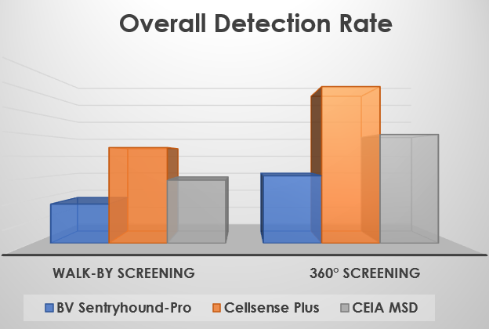
Commercial in Confidence
Metrasens’ Cellsense Plus detected up to
150% more contraband items than its competitors
On detecting small contraband items in a walk-by screening (excluding cell phones):
144% more than BV Sentryhound-Pro
52% more than CEIA MSD
132%
44%
Cellsense Plus
144%
52%
Cellsense Plus
CEIA MSD
CEIA MSD
On detecting small contraband items in a 360° screening (excluding cell phones):
132% more than BV Sentryhound-Pro
44% more than CEIA MSD
Notes:
金属 雷达 传感器

Slide 10
Commercial in Confidence
False Positive Results / Far Field Susceptibility
A null test (without any threat items) carried out after each 10 passes to check for false positive results (false alarms).
Observed that Cellsense Plus was very much less sensitive compared to CEIA MSD, which was very sensitive to moving metal outside the test area. E.g.:
Opening & closing of doors
Vehicles moving in the carpark
Results subjected to 2-way analysis of variance at 95% confidence level and there were significant differences between the means for each model of scanner. The Normal Scores method was then applied to the results. This showed that the number of inadvertent detections / reactions noted during the test was very significantly higher for the CEIA MSD than for the other 2 scanners.
4X as many inadvertent detections / reactions were noted for CEIA MSD than for Cellsense Plus. Slightly fewer inadvertent detections / reactions were noted for BV Sentryhound-Pro than Cellsense Plus but this difference was not statistically significant.

Slide 11
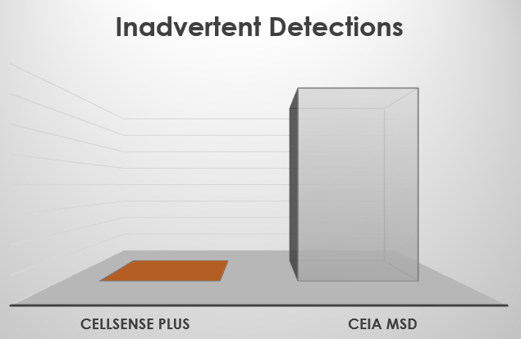
Commercial in Confidence
SUMMARY
The results are DRAMATIC:
Cellsense Plus significantly outperforms the CEIA MSD in all independent test categories
Walk by screening Cellsense Plus detects 52% more contraband items.
360° screening Cellsense Plus detects 44% more contraband items.
Cellsense Plus is dramatically better at finding smaller items of contraband.
Four times as many inadvertent detections / reactions were noted for the CEIA MSD
CEIA MSD has significantly higher False Positive Results / Far Field Susceptibility.
4X FALSE ALARMS
Notes:
金属 雷达 传感器

Slide 12
Commercial in Confidence
SEE THE UNSEEN
www.metrasens.com

